Slide 1

Final Year Project
AI Avatar for Academic Advising using Fine-Tuned Large Language Model
Integrating Retrieval-Augmented Generation with Voice-Enabled AI Avatar Technology
Student
Supervisor
Jet Saw Jun Jie
Dr. Tan Wooi Haw
ID: 1231303401

Slide 2
01 / Introduction
The Challenge of Academic Advising
The AI Solution
Critical Support Service
Recent advances in artificial intelligence provide an opportunity to automate routine academic advising while maintaining accuracy and accessibility.
Academic advising helps students understand programme structures, subject prerequisites, and graduation requirements—essential for academic success.
Project Proposal
Traditional Limitations
Manual consultations and static documents (handbooks, PDFs) create bottlenecks during peak periods.
An AI-based academic advising system enabling natural language and voice-based interaction , with responses grounded in official faculty documents.
Peak Period Challenges
Advisors face high workloads while students experience delays in receiving accurate information.

Slide 3
02 / Objectives
Project Objectives
Primary Objectives
Secondary Objectives
01
Fine-tune Large Language Model
Using faculty and programme information for domain-specific responses
Reduce Staff Workload
Automate routine queries to free up advisor time
02
Implement RAG Pipeline
Retrieval-Augmented Generation for factual accuracy
Improve Response Time
Support Voice Interaction
Instant answers for students without waiting
03
Natural two-way voice-based academic advising
Enhance Engagement
AI avatar for more interactive user experience

Slide 4
03 / Project Overview
Two-Phase Development Approach
1
Phase 1
2
Phase 2
HIVE Academic Chatbot
AI Avatar Development
Unity-Based Avatar
RAG Pipeline
3D avatar interface with realistic animations
Document-grounded responses ensuring factual accuracy
Backend Intelligence
Finetune Model
Lip Synchronisation
Timeline: Semester 1 (Week 3-13)
Real-time facial movement alignment with speech
Timeline: Semester 2 (Week 1-13)
Phased Approach Rationale
This phased development ensures system accuracy and reliability are established in Phase 1 before introducing visual interaction elements in Phase 2. By validating the backend intelligence first, we minimize risks and ensure a robust foundation for the avatar interface.

Slide 5
04 / Literature Review
Large Language Models
Capabilities and Limitations in Academic Contexts
Capabilities
Limitations
Natural Language Understanding
Probabilistic Generation
LLMs demonstrate strong performance in understanding context and generating human-like responses
Responses based on language patterns rather than verified knowledge
Hallucination Risk
Conversational Tasks
Can generate incorrect or fabricated information in domain-specific tasks (OpenAI, 2023)
Effective at maintaining dialogue context and responding appropriately to user queries
Few-Shot Learning
Academic Advising Challenge
Can perform diverse tasks with minimal examples (Brown et al., 2020)
Critical need for factual accuracy in educational contexts
"Large transformer-based models can perform a wide range of tasks through few-shot learning, demonstrating remarkable language understanding capabilities."
APA Citation
(Brown et al., 2020; OpenAI, 2023)
— Brown et al. (2020), Advances in Neural Information Processing Systems

Slide 6
04 / Literature Review
Fine-Tuning
Domain Adaptation and Its Boundaries
Fine-Tuning Process
Benefits
Significantly improves domain relevance (Devlin et al., 2019)
1
Pre-trained Model
Start with general-purpose LLM
Enhanced downstream task performance
Better understanding of faculty-specific terminology
2
Curated Dataset
Domain-specific training data
Limitations
Does not guarantee factual correctness (OpenAI, 2023)
Domain-Adapted Model
Limited adaptability to changing academic policies
3
Specialized for specific tasks
Requires retraining for policy updates
Fine-tuning improves language behavior and domain understanding, but additional mechanisms (like RAG) are needed to ensure factual accuracy and policy compliance.
(Devlin et al., 2019; OpenAI, 2023)

Slide 7
04 / Literature Review
Retrieval-Augmented Generation
Combining Document Retrieval with Text Generation
1
2
3
Document Corpus
Retrieval
Generation
Official academic documents and policies
Find relevant document chunks
Grounded response synthesis
Key Advantages
Perfect for Academic Advising
Factual Accuracy
Policy Compliance
Significantly improves factual accuracy in knowledge-intensive tasks (Lewis et al., 2020)
Ensures answers align with official programme and faculty documents
Document Grounding
Responses aligned with official documents rather than model memory
Dynamic Updates
Reduced Hallucination
Easy to update knowledge base without retraining the model
Minimizes incorrect information by grounding responses in verified sources
Traceability
Can cite sources for transparency and verification
"RAG significantly improves factual accuracy in knowledge-intensive tasks by grounding responses in retrieved documents."
(Lewis et al., 2020)

Slide 8
04 / Literature Review
Voice & Avatar Interaction
Enhancing Accessibility and Engagement
Voice Interaction
Avatar Interaction
Improved Accessibility
Enhanced Engagement
Voice-based systems improve usability for diverse user groups
Embodied conversational agents increase user engagement compared to text-only systems (Cassell et al., 2000)
Robust Speech Recognition
Whisper provides robust recognition across accents and noisy environments (Radford et al., 2023)
Increased Trust
Visual presence builds user confidence and rapport
Natural Communication
Realism Through Lip Sync
Enables hands-free, conversational interaction
Lip synchronisation improves realism by aligning speech with facial movement (Taylor et al., 2017)
The Synergy Effect
Combining voice interaction with embodied avatars creates a more natural, accessible, and engaging user experience than either technology alone. This multimodal approach is particularly valuable for academic advising, where clear communication and user trust are essential.
APA Citation
(Radford et al., 2023; Cassell et al., 2000; Taylor et al., 2017)

Slide 9
05 / Research Gap
Identified Research Gaps
LLM Hallucination
Fine-Tuning Limitations
Large Language Models alone are prone to generating hallucinated or incorrect information when applied to domain-specific tasks.
Fine-tuning improves language behavior but does not guarantee factual grounding or adaptability to changing policies.
Solution: RAG Pipeline
Solution: Document Retrieval
RAG-Avatar Disconnect
Integration Gap
RAG systems that improve accuracy are rarely combined with avatar interfaces for enhanced user experience.
Few systems integrate LLM + RAG + voice interaction + lip-synchronised avatars for academic advising.
Solution: Unity Integration
Solution: Comprehensive System
Project Contribution
This project addresses these gaps through an integrated academic advising system that combines fine-tuned LLMs, RAG for factual accuracy, voice interaction for accessibility, and Unity-based avatars with lip synchronisation for enhanced engagement—creating a comprehensive solution not found in existing research.

Slide 10
06 / System Design
System Architecture Overview
Modular and Scalable Design
System Components
Key Features
Voice-Enabled Frontend Interface
Modular Design
Unity-based avatar with speech input/output
Each component can be updated independently
Scalable Architecture
Backend API Server
Supports multiple concurrent users
RESTful API handling requests and responses
API-Driven
Easy integration with other systems
RAG Pipeline
Fine-Tuned LLM
Document retrieval and context injection
Domain-specific response generation
Design Philosophy: The modular architecture ensures that each component can be developed, tested, and deployed independently, reducing complexity and enabling iterative improvements.
Unity-Based AI Avatar
3D avatar with real-time lip synchronisation

Slide 11
07 / RAG Pipeline
RAG Pipeline Overview
Ensuring Factual Accuracy Through Structured Processing
QA Pair Generation
Document Chunking
Chunk Differentiation
Embedding
Retrieval
Answer Generation
Structured question-answer pairs
Semantic unit separation
Academic category tagging
Vector representation
Similarity search
Grounded response
Core Principle
Accuracy Guarantee
Dynamic Updates
The RAG pipeline separates knowledge retrieval from language generation, ensuring responses are grounded in verified documents rather than model hallucinations.
By retrieving relevant document chunks before generating responses, the system ensures factual accuracy and policy compliance in all academic advising interactions.
The knowledge base can be updated without retraining the model, enabling quick adaptation to changing academic policies and programme structures.
Pipeline Flow: Academic documents → QA pairs → Chunks → Tagged categories → Vector embeddings → Similarity retrieval → Grounded answer generation

Slide 12
07 / RAG Pipeline
RAG Pipeline: Detailed Steps
1
QA Pair Generation
2
Document Chunking
3
Chunk Differentiation
Convert academic documents into structured question-answer pairs
Split documents into small semantic units for precise retrieval
Tag chunks by academic category for targeted retrieval
Method:
Categories:
Input:
Semantic chunking with overlap for context preservation
Programme structure, prerequisites, policies, procedures
Programme handbooks, course catalogs, policy documents
4
Embedding
5
Retrieval
6
Answer Generation
Convert chunks into vector representations for similarity search
Retrieve relevant chunks using similarity search
Generate responses grounded in retrieved content
Method:
Output:
Model:
Cosine similarity in vector database (e.g., FAISS, Pinecone)
Factual, contextually relevant academic advising responses
Sentence transformers for semantic embeddings
Pipeline Integration
These six steps work sequentially to transform raw academic documents into a queryable knowledge base that ensures every response is grounded in official faculty documentation, eliminating hallucination while maintaining natural language fluency.

Slide 13
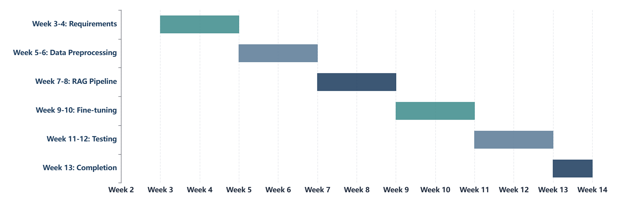
08 / Project Timeline
Phase 1: HIVE Academic Chatbot
Semester 1 (Week 3 – Week 13)
Duration
Key Deliverable
Milestone
11 weeks (Week 3-13)
Fully functional HIVE chatbot
Backend system completion

Slide 14
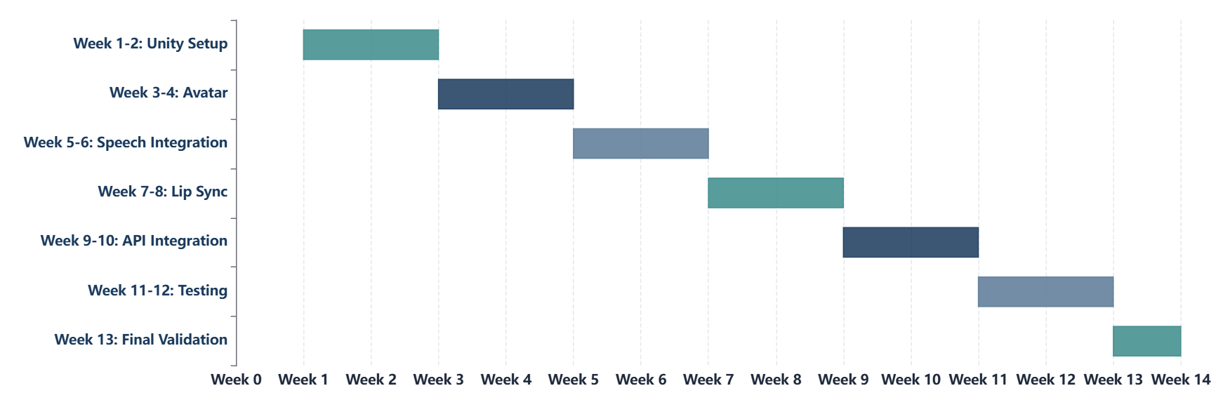
08 / Project Timeline
Phase 2: AI Avatar Development
Semester 2 (Week 1 – Week 13)
Duration
Key Deliverable
Milestone
13 weeks (Week 1-13)
Complete AI avatar system
Final system validation

Slide 15
09 / Conclusion
Project Conclusion
Key Contributions
System Benefits
Fine-Tuned LLM
Accuracy
Domain-specific language model for academic contexts
Reduced hallucination through RAG
Accessibility
RAG Pipeline
Voice interaction for all users
Factual accuracy through document-grounded responses
Engagement
Avatar enhances user experience
AI Avatar Interface
Unity-based avatar with voice and lip synchronisation
Phased Development
Ensures reliability before visual enhancement
Project Impact
This project demonstrates that combining fine-tuned Large Language Models with Retrieval-Augmented Generation and a Unity-based AI avatar can deliver accurate, accessible, and engaging academic advising support. The phased development approach ensures reliability, reduces hallucination, and enhances user experience—addressing critical gaps in existing academic support systems.

Slide 16
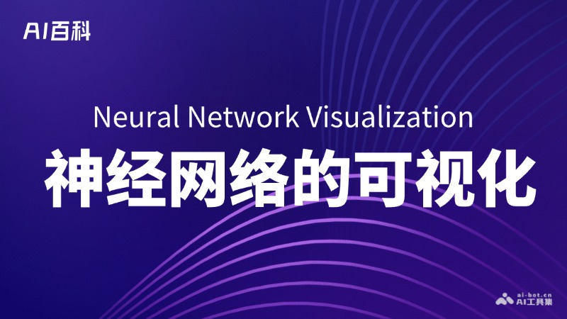
10 / References
References
APA 7th Edition
Brown, T., Mann, B., Ryder, N., et al. (2020). Language models are few-shot learners. Advances in Neural Information Processing Systems, 33, 1877–1901.
Radford, A., Kim, J. W., Hallacy, C., et al. (2023). Whisper: Robust speech recognition via large-scale weak supervision. https://arxiv.org/abs/2212.04356
Devlin, J., Chang, M.-W., Lee, K., & Toutanova, K. (2019). BERT: Pre-training of deep bidirectional transformers for language understanding. NAACL-HLT.
Cassell, J., Sullivan, J., Prevost, S., & Churchill, E. (2000). Embodied conversational agents. MIT Press.
Lewis, P., Perez, E., Piktus, A., et al. (2020). Retrieval-augmented generation for knowledge-intensive NLP tasks. NeurIPS.
Taylor, S., Theobalt, C., & Matthews, I. (2017). Deep learning for facial animation from speech. ACM Transactions on Graphics (SIGGRAPH).
OpenAI. (2023). GPT-4 technical report. https://arxiv.org/abs/2303.08774
Thank You
Questions & Discussion
Faculty of Artificial Intelligence and Engineering | February 2026

